Slide 1

SKIN CANCER DETECTION
Presented By
KISLAY
SALMAN

Slide 2

INTRODUCTION
Skin cancer is one of the most frequent cancers not only in the United States but also worldwide, with about 10,000 people diagnosed with it in the United States every day. Despite the fact that the number of Melanoma deaths is expected to rise by 22% in the coming year, early identification of the disease can lead to a 99% survival rate.
Early detection of skin cancer is critical and can prevent further spread in some cases, such as melanoma and focal cell carcinoma. In any case, there are several factors that have a negative impact on detection accuracy. In recent years, the use of image processing and computer vision in healthcare and medical applications has increased significantly.
In this project, we use deep learning techniques to detect and categorize cancer based on dermatoscopic images of pigmented lesions.

Slide 3
TOOLS AND TECHNIQUES
PYTHON | COMPUTER SPEC - GOOGLE COLAB
PACKAGES NUMPY, PANDAS, MATPLOTLIB TENSORFLOW, SCIKIT LEARN.

Slide 4
DESCRIPTION OF THE DATASET
The study of skin disease analysis focuses primarily on the main causes and factors that have a serious impact on health.
The dataset and the images used are from Harvard Dataverse(Human Against Machine HAM10000).
The dataset contains:
A .csv file that contains information about the patient
the image_id of the probable cancer-causing mole.
Age of the patient
Sex of the patient
Location of the mole
A folder containing images of the probable cancerous mole
This dataset is a large collection of multi-sources dermatoscopic images of pigmented lesions from different populations, acquired and stored by different modalities. The final dataset consists of 10015 dermatoscopic images which can serve as a training set for our project.

Slide 5

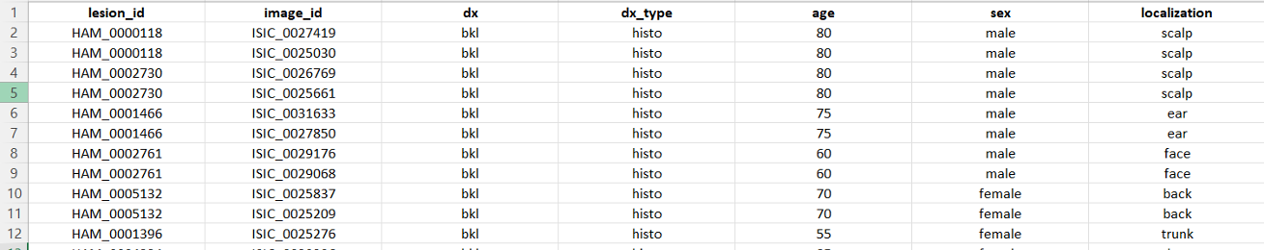
.csv file from the dataset
Notice that column dx provides us with the abbreviations for each type of skin cancer. There are a total of seven types that we aim to classify in this project. The seven types are:
• Melanocytic nevi (nv)
•Melanoma (mel)
•Benign keratosis-like lesions (bkl)
•Basal cell carcinoma (bcc)
•Actinic keratoses (akiec)
•Vascular lesions (vas)
•Dermatofibroma (df)

Slide 6
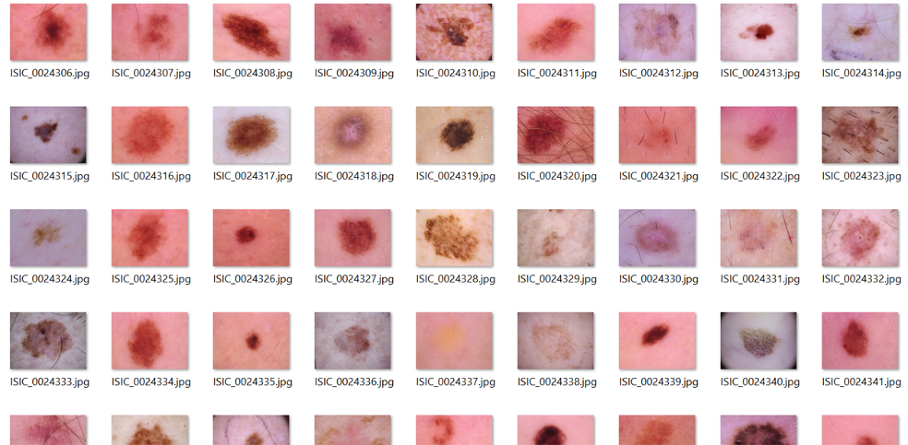

This is a snippet of the folder with all the images

Slide 7
DATA PREPARATION
Image Data Merging: We started by merging image data from two separate folders into a single dataset, creating mappings between image IDs, file paths, and lesion types. It also includes a CSV file that provides metadata for the images.
Metadata Handling: A CSV file containing metadata for the images is read into a DataFrame. This metadata includes information such as the diagnosis (dx), which is a short code indicating the type of skin lesion each image represents.
Lesion Type Dictionary: We then created a dictionary (lesion_type_dict) to map these diagnosis codes to their full names, providing a clear text description for each lesion type.
Label Mapping: We also created two dictionaries for label encoding and decoding. label_mapping is used to map the textual labels to numerical values, which are needed for the machine learning model to process. Conversely, reverse_label_mapping provides a way to convert the numerical labels back into their original text form.

Slide 8

DATA PREPROCESSING
01
Resizing
02
Data Augmentation
03
Normalization
04
Train-Test Split

Slide 9
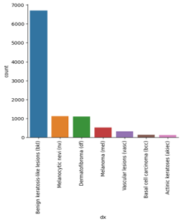
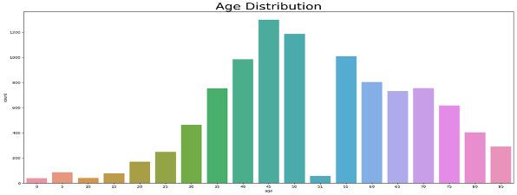

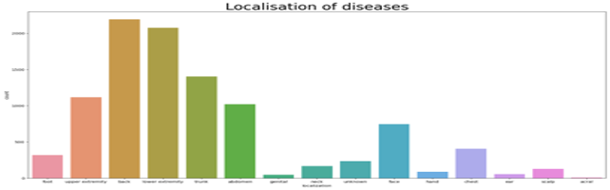
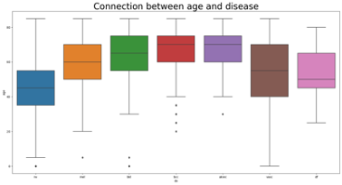
DATA VISUALIZATION
Different types of skin disease

Slide 10
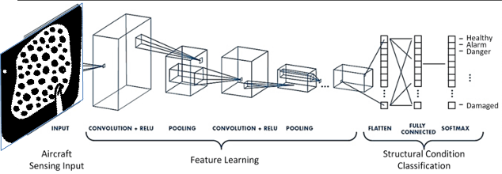
MODEL ARCHITECTURE
We chose a Convolutional Neural Network (CNN) for this project due to its effectiveness in image recognition and classification tasks. The goal of this model is to accurately classify skin cancer images into seven categories.

Slide 11
1 | 2 | 3
For compiling the model, We used the Adam optimizer with a learning rate of 0.001 | Relu was utilized as the activation function for the first two dense layers, and Softmax was used for the final layer | We utilized the EarlyStopping Method to train the data.
MODEL COMPILATION

Slide 12
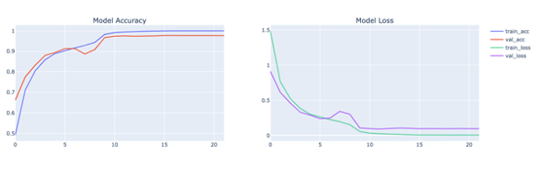
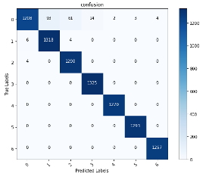

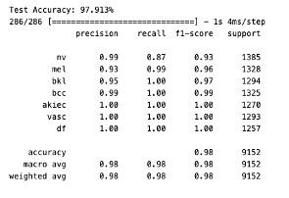
MODEL EVALUATION/RESULT
Confusion Matrix
Accuracy, Precision, Recall, and F1-Score
Analyzing Loss and Accuracy Trends
CONFUSION MATRIX
TEST ACCURACY

Slide 13
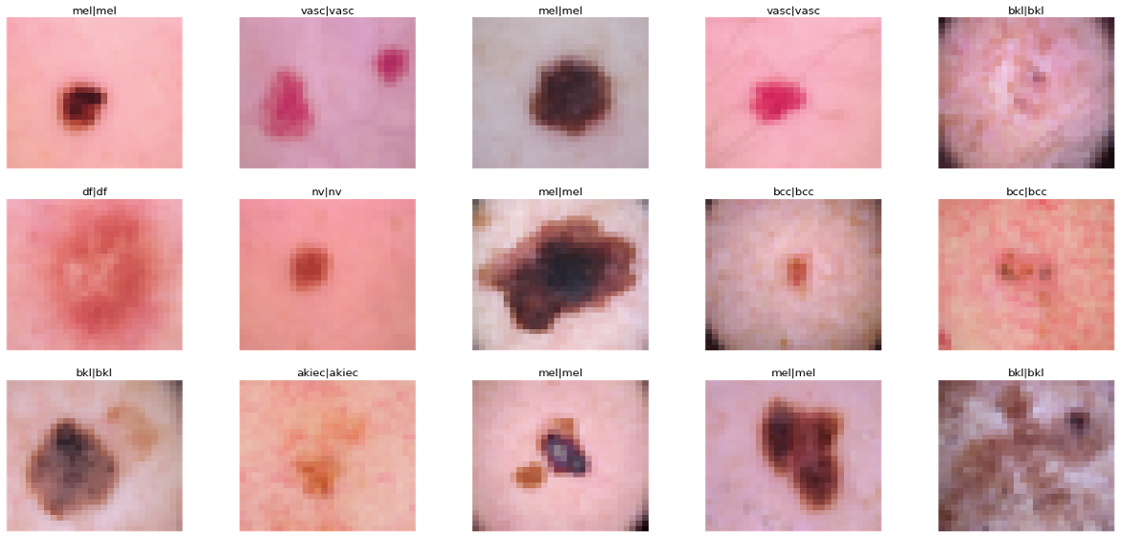

Slide 14

CONCLUSION
We successfully demonstrated the effectiveness of Convolutional Neural Networks in classifying skin cancer images. We tailored the model architecture for image-based classification, showing promising results in identifying various skin cancer types. Employing data augmentation was a pivotal decision. It helped us address the challenge of an imbalanced dataset and enhanced the model's ability to generalize by training it on a more varied set of images. Through rigorous evaluation, including the use of a confusion matrix and K-fold cross-validation, the model exhibited reliable performance. The key metrics - accuracy, precision, recall, and F1-score - indicated a high level of correctness in predictions.
Areas for Future Improvement: While the model performed well, there's always room for improvement. Future work could explore deeper architectures, more sophisticated data augmentation techniques, or even the incorporation of additional data sources to further enhance the model's accuracy and generalizability.

Slide 15










THANK YOU !!

